Slide 1

Chapter 5.6
Results for Continuous-Time GI/GI/1-∞
Performance Evaluation of the Internet of Things (IoT)
Module Course: Performance Evaluation of Distributed Systems
Prof. Tobias Hoßfeld, Summer Semester 2022

Slide 2
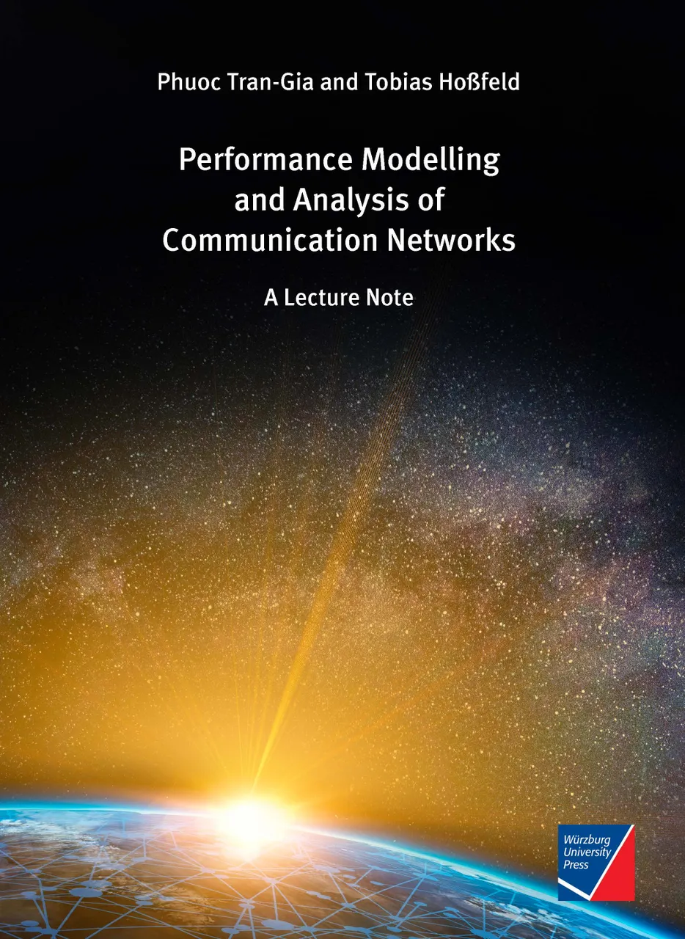
Disclaimer and Copyright Notice
Lecture slides, figures, and scripts are based on the open access text book “Performance Modeling and Analysis of Communication Networks”. The book and scripts are licensed under the Creative Commons License Attribution-ShareAlike 4.0 International (CC BY-SA 4.0). If you remix, transform, or build upon the material, you must distribute your contributions under the same license as the original.
The book must be cited and the disclaimer attached when using lectures slides or scripts.
Tran-Gia, P. & Hossfeld, T. (2021). Performance Modeling and Analysis of Communication Networks - A Lecture Note. Würzburg University Press. https://doi.org/10.25972/WUP-978-3-95826-153-2
Website to download book, exercises, slides and scripts: https://modeling.systems/

Slide 3
Chapter 5
5 Analysis of Non-Markovian Systems
5.1 Discrete-Time Markov Chain
5.2 Method of Embedded Markov Chain
5.2.1 Power Method for Numerical Derivation
5.2.2 Notion of Embedding Times
5.2.3 Kleinrock’s Result
5.3 Delay System M/GI/1
5.3.1 Model Structure and Parameters
5.3.2 Markov Chain and State Transition
5.3.3 State Equation
5.3.4 State Probabilities
5.3.5 Delay Distribution
5.3.6 Other System Characteristics
5.3.7 State Probabilities at Arbitrary Time
5.4 Delay System GI/M/1
5.4.1 Model Structure and Parameters
5.4.2 Markov Chain and State Transition
5.4.3 State Probabilities
5.4.4 State Analysis with Geometric Approach
5.4.5 Waiting Time Distribution
5.5 Model with Batch Service and Threshold Control
5.5.1 Model Structure and Parameters
5.5.2 Markov Chain and State Transition
5.5.3 State Probabilities and System Characteristics
5.6 Results for Continuous-Time GI/GI/1 Delay Systems
5.6.1 Characteristics of GI/GI/1 Delay Systems
5.6.2 Lindley Integral Eq. GI/GI/1 Systems
5.6.3 Kingman’s Approximation of Mean Waiting Times

Slide 4
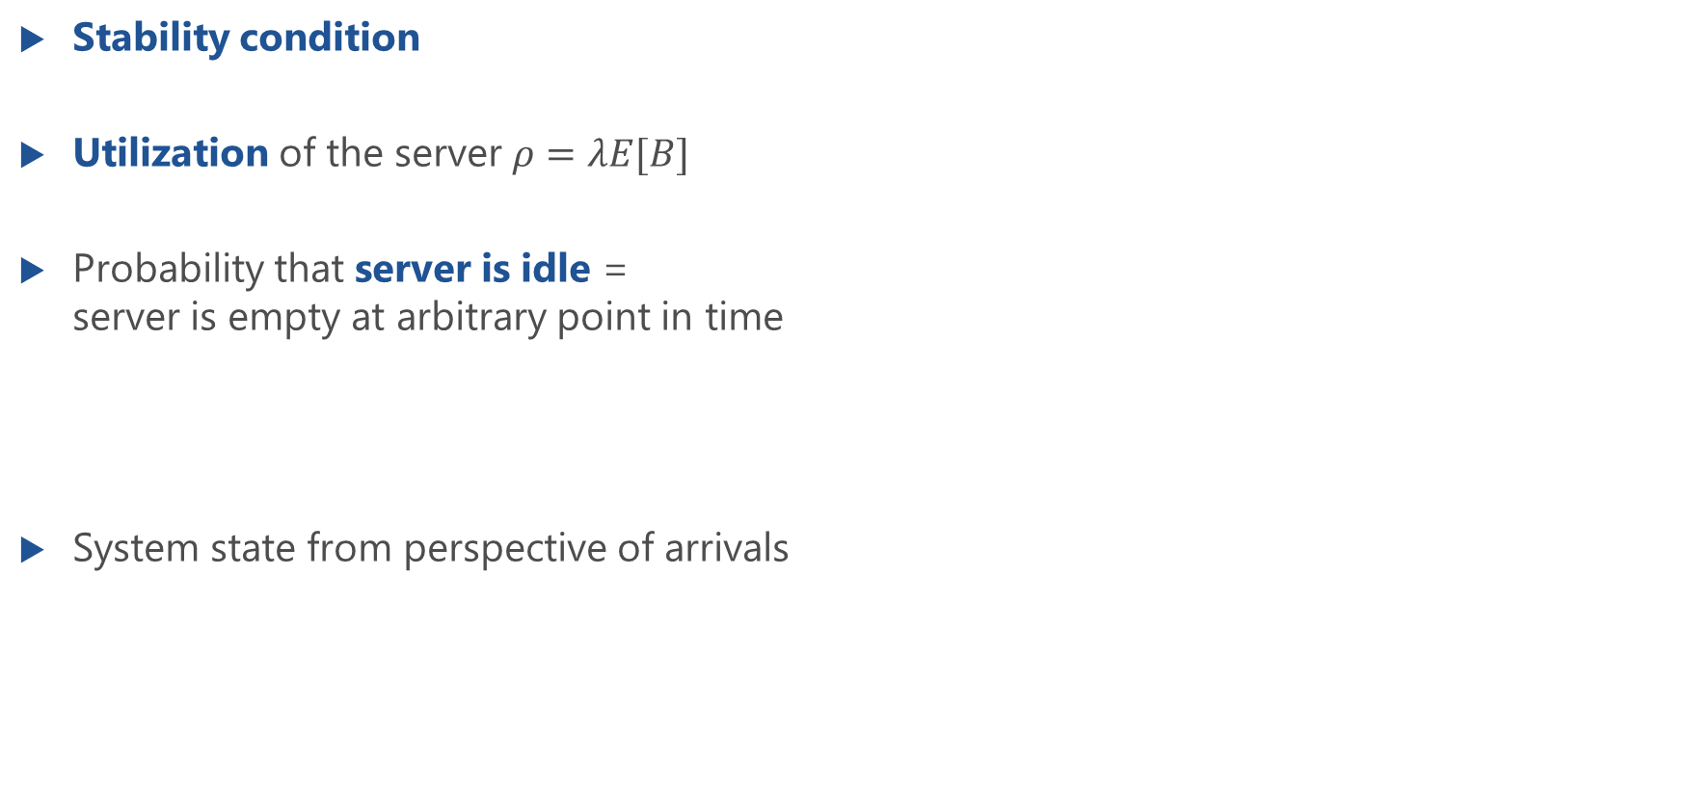
Characteristics of GI/GI/1 Delay Systems
Stability condition
Utilization of the server $ρ=λE[B]$
Probability that server is idle = server is empty at arbitrary point in time
System state from perspective of arrivals

Slide 5
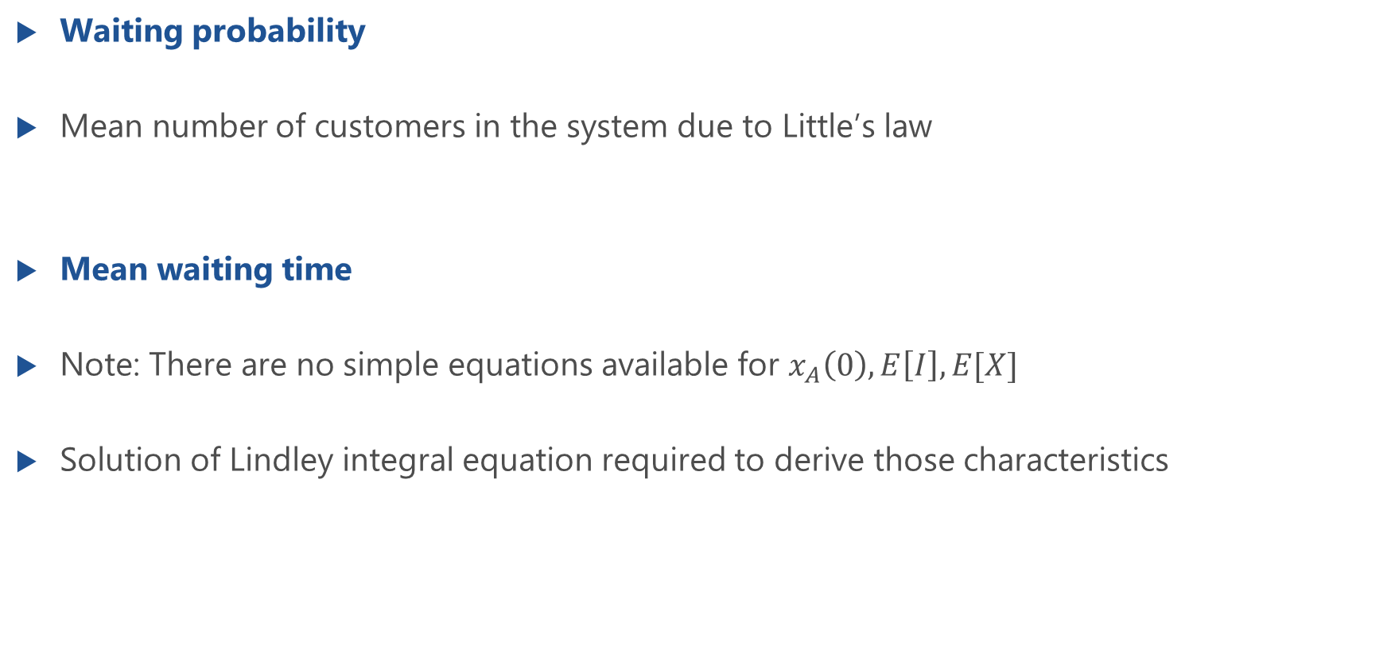
Characteristics of GI/GI/1 Delay Systems (f.)
Waiting probability
Mean number of customers in the system due to Little’s law
Mean waiting time
Note: There are no simple equations available for $x_{A}\left(0\right),E\left[I\right],E[X]$
Solution of Lindley integral equation required to derive those characteristics
derivation of waiting times for discrete-time GI/GI/1 queue

Slide 6
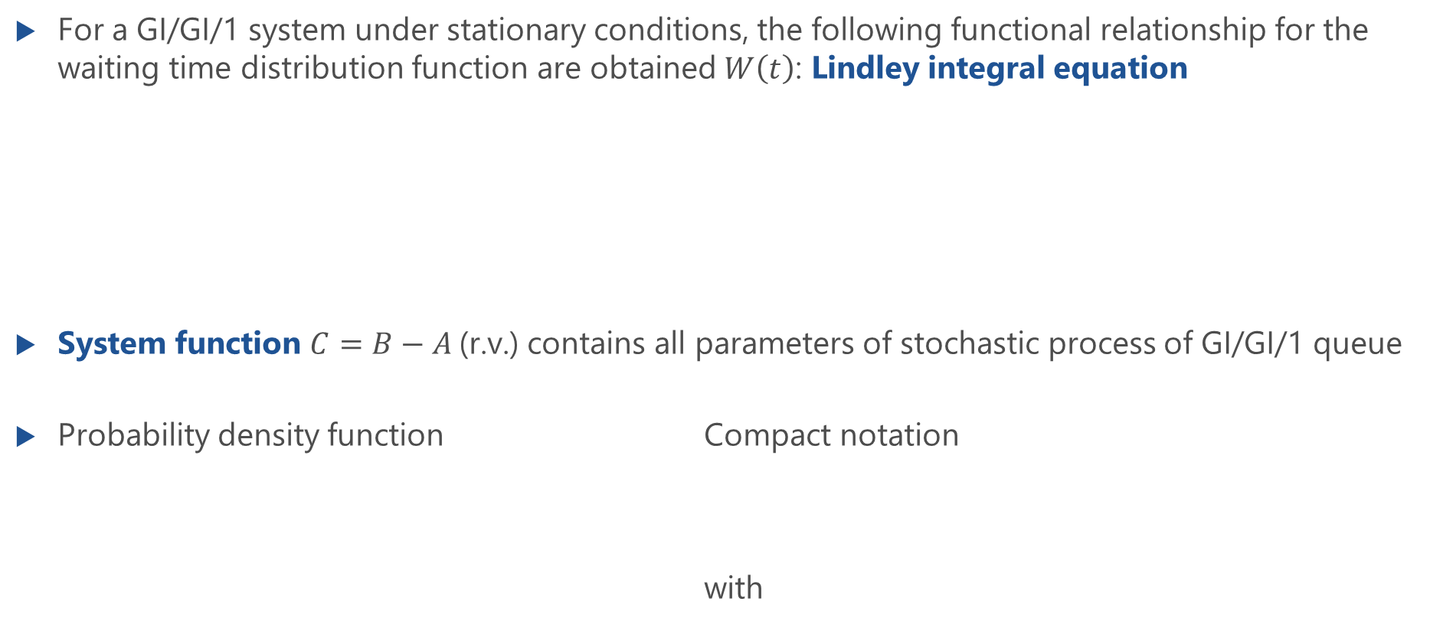
Lindley Integral Equation for GI/GI/1 Systems
For a GI/GI/1 system under stationary conditions, the following functional relationship for the waiting time distribution function are obtained $W\left(t\right)$: Lindley integral equation
System function $C=B−A$(r.v.) contains all parameters of stochastic process of GI/GI/1 queue
Probability density function Compact notation with

Slide 7
Kingman’s Approximation of Mean Waiting Times
Kingman provides an approximation for the mean waiting time: Kingman’s formula
For a Poisson process, Kingman’s formula is exact
Tighter upper bound of the mean waiting time is provided by Daley
Difference between upper bound and approximated mean
Relative difference

Slide 8
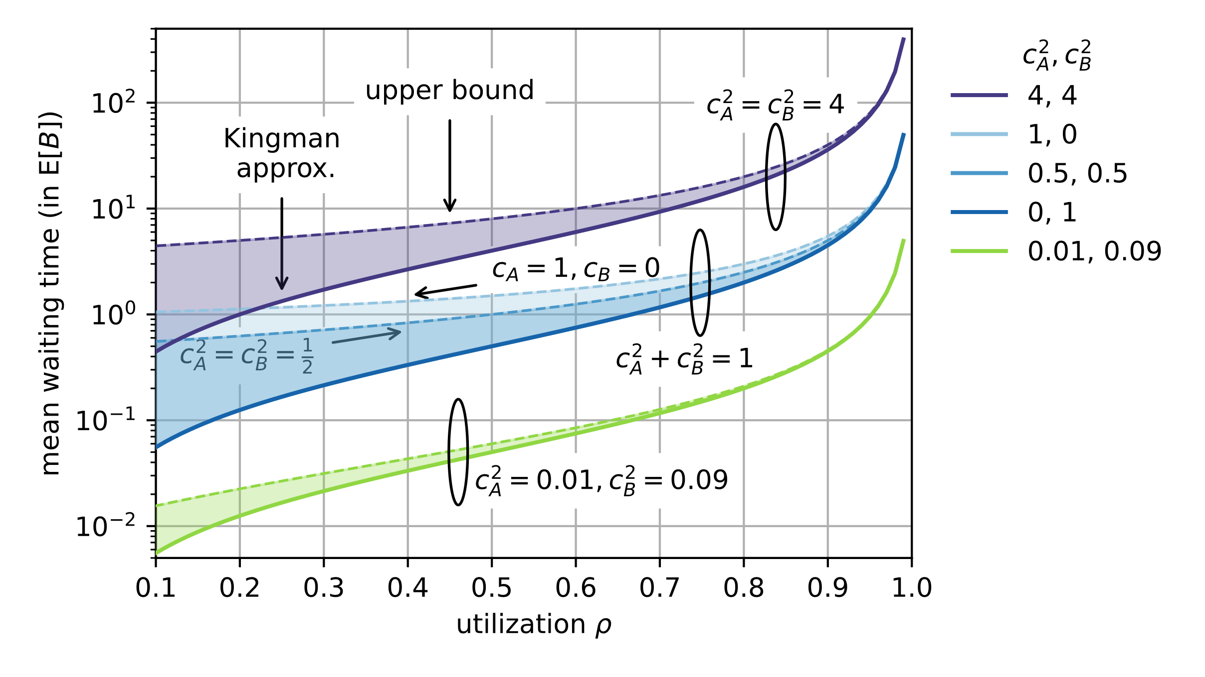
Kingman’s Approximation and Tight Upper Bounds

Slide 9
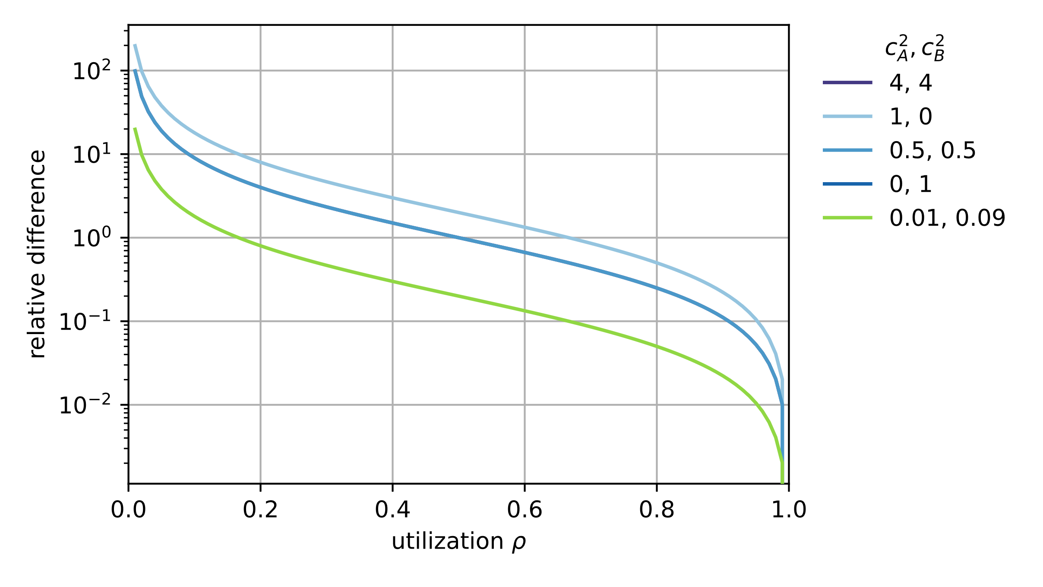
Relative Difference

